Slide 1

DESIGN AND DEVELOPMENT OF AN ENHANCED E-LEARNING PLATFORM FOR AN INTERACTIVE EDUCATIONAL EXPERIENCE
BY:
CHRISTIAN NII COMMEY SOLOMON - 040918451
JEREMY EDUDZI AVADZI - 4121210061
SUPERVISOR:
DR. KISEMBE
GHANA COMMUNICATION TECHNOLOGY UNIVERSITY

Slide 2
INTRODUCTION
Overview of e-learning
Rise of e-learning during the pandemic
E-learning vs the Traditional Pedagogical System (Opportunites and Challenges)
Limitations of Traditional Pedagogical System
Importance of Digital Platforms in Higher Education; [Examples of e-learning systems]
Success of E-learning Systems
The context of education defined within the framework of an e-learning platform
Educational democratisation.

Slide 3
PROBLEM STATEMENT
Current state of education at GCTU
Challenges faced by students at GCTU
Limited accomodation and accessibiity issues
High Cost of existing solutions.
Proposed Solution
Development of comprehensive e-learning platform
Addressing challended through e-learning
Need for custom, cost-effective solution

Slide 4
OBJECTIVES
Development of an e-learning platform
video-conferencing
online integrated development environment
centralised repository [ inlcuding recorded lecture sessions ]
Scope and Limitations
Brief Methodology
Design Concept
Benefits
Recommended Approach

Slide 5
LITERATURE REVIEW
Definition of terms
WebRTC
Web Sockets
Server Side Rendering
Scalable DBMS
Containerization
System Architecture Design
Current Issues of concern
Challenges faced by Uiversities in Ghana
Increasing demand for flexible and accessible learning options

Slide 6
Reference | Authors | Summary | Year
[1] | (Muhammad H. Hussaini) | Surge in admission requests vs limited resources Proposes the adaptation of e-learning systems Developed virtual classroom | 2022
[2] | ( Robert Oliwa ) | Process of designing e-learning platform for 3 user groups Can users help in defining its functionalities Uses a mixed method approach to assess design and functionality | 2021
[3] | (Adabogo Emmanuel, Gertrude Fafali) | Aim to improve overall learning experience for tutors and learners Used WebRTC for video & audio lectures as well as screen sharing Eliminate the need for costly subscriptions | 2022

Slide 7
Reference | Authors | Summary | Year
[4] | (Peter Appiahene, Christopher Ninfaakang) | Use of elearning to improve teaching and learning of certain courses at UENR Developed web based e-learning platform Accomodated over 300 students each year for two years implemented group discussions, self evaluation assessments, multimedia information, etc. | 2017
[5] | ( Patrick Nyirenda ) | Provide e-learning services to rural secondary schools - making education more accessible A centralised repository, much like GCTU LMS | 2019
[6] | (Nawar S. A., et.al) | development of e-learning platform for Iraqi universities. aimed to provide and interactive interface to overcome the limitations of traditional education in the context of Iraq Used a layered deesiggn approach, ADDIE | 2022
[6] | (W. L. Chu et.al) | presents the development of an e-learning platform for teaching construction technology to undergraduates, aiming to improve learning for those lacking internship experience. details module design, including study guides, readings, videos, and quizzes. Evaluation via a survey indicates students find the blended learning approach significantly enhances their learning experience. | 2019

Slide 8
Reference | Strengths | Limitations
[1] | highlights the issue of pressure on education resources globally, setting a relevant context for the proposed solution proposes good comprehensive solution in the development of a new learning environment. recognized the need for a supplement for teaching and learning through the implementation of a virtual classroom. prioritizes functionality and usability, aligning with the study's objectives. | lacks videoconferencing capabilities. This limitation could restrict the interactive and engaging quality of online lectures does not include ways for encouraging active involvement and participation in the virtual classroom setting.
[2] | the study gathered a wide spectrum of viewpoints from students, teachers, and administrative personnel comprehensive synthesis of findings, resulting in useful suggestions for improving the design and effectiveness of an online educational platform. | The study sample size which was used might have been limited which would mean that the conclusions drawn from the study cannot be applicable in a more generalized setting or outside the context of the research.
[3] | utilizing WebRTC technology and implem focus on cost-effectivenessenting real-time screen sharing capabilities screen-sharing capabilities, chat, file-sharing, and audio streaming prioritizes scalability, with up to 26 individuals using a single 4G WIFI interface | may not include all aspects of e-learning, including assessment methodologies, curriculum design, and learner engagement strategies. may have technical restrictions such as bandwidth, latency, and device compatibility

Slide 9
Reference | Strengths | Limitations
[4] | accommodating different ways in which students may absorb information effectively convenience for both students and staff | challenges in gathering information and data from users for an objective assessment of the proposed e-learning products
[5] | Administrative capabilities Implementation of a Data Flow Diagram to visualize the overall application data flow and processes of the e-learning system. | consistent access to the system
[6] | Ease of Use Accuracy and Quality Efficient Material Management Interactive Environment User-Friendly Navigation | Lack of Videoconferencing Absence of Methods for Encouraging Active Involvement
[7] | well-structured course materials, ease of accessing online learning materials, effectiveness of the animations | Limitation related to the quiz design of the course

Slide 10
IDENTIFIED GAPS
Absence of Video Conferencing Features
Lack of Comprehensive User Involvement
Limited Assessment and Evaluation Method

Slide 11
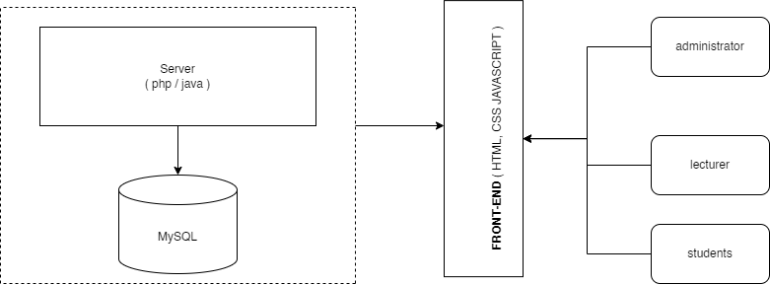

Slide 12
